Slide 1

LOCUS and some figures
Labs of Contextualized Urban Social Work

Slide 2
LOCUS central questions
How can social workers gain a good understanding of the experiences, needs and preferences of urban residents?
How can social workers involve citizens and their knowledge in more collaborative and more inclusive ways?

Slide 3
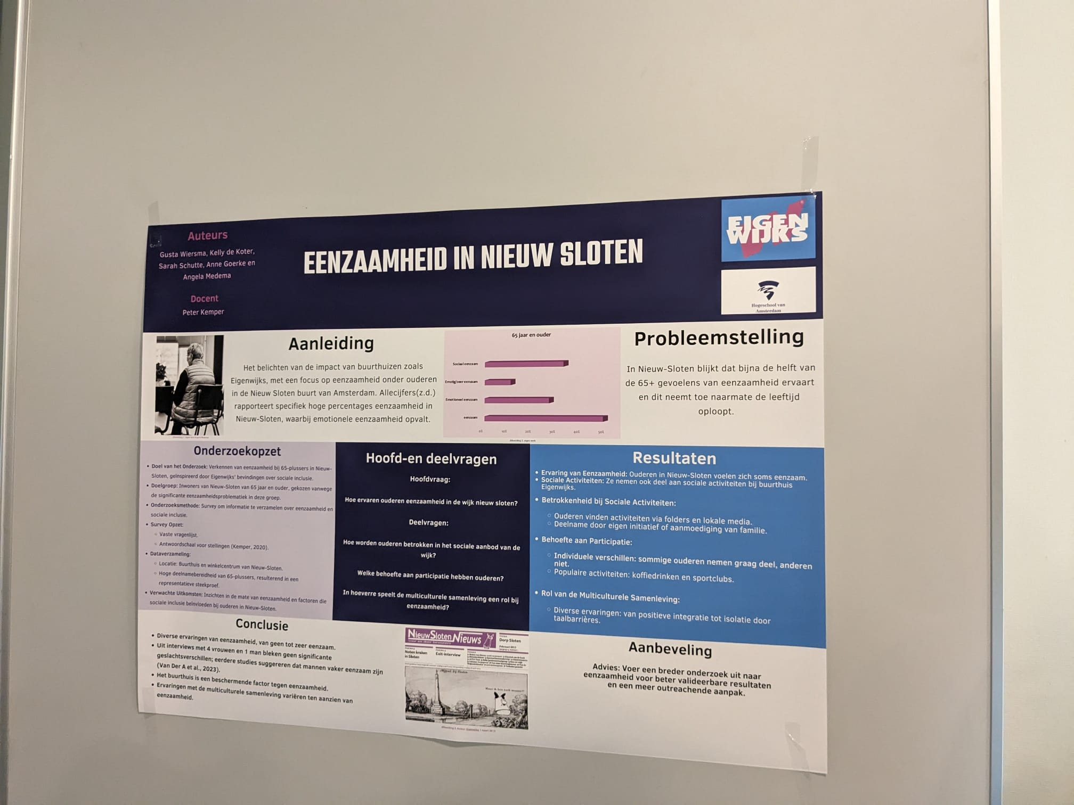
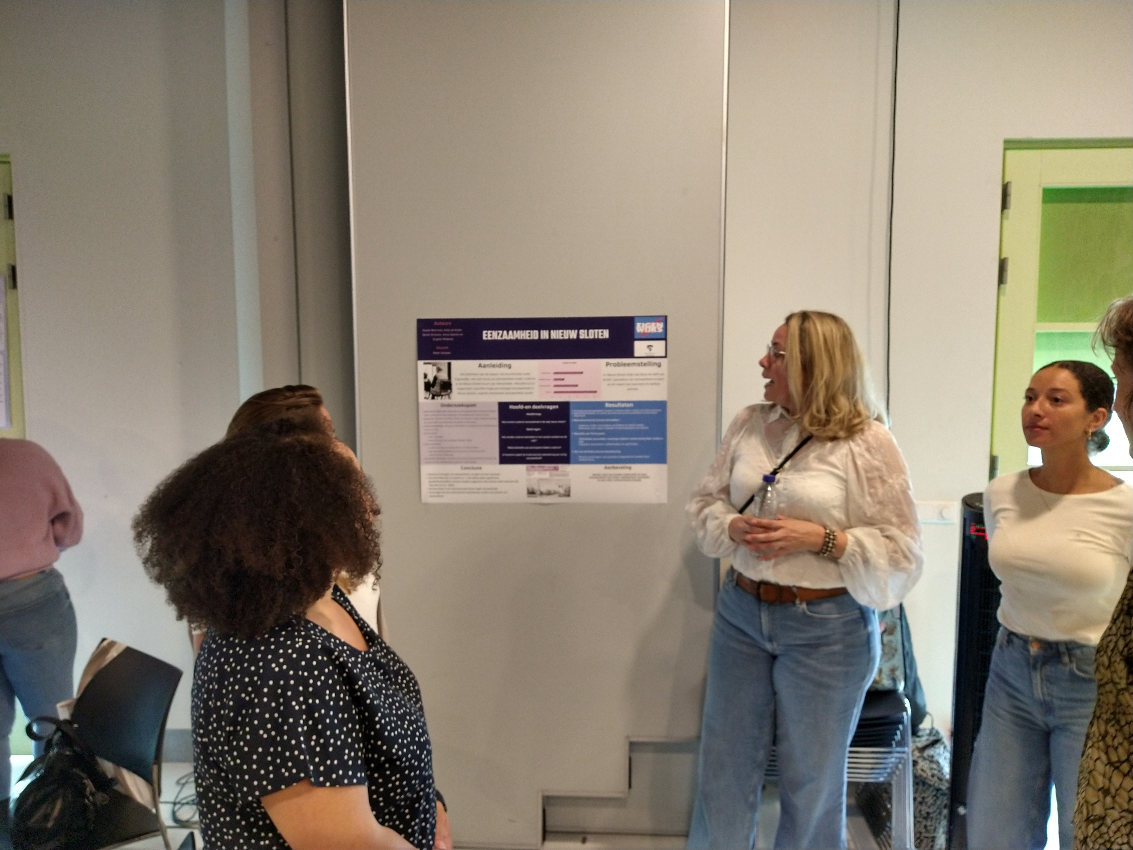
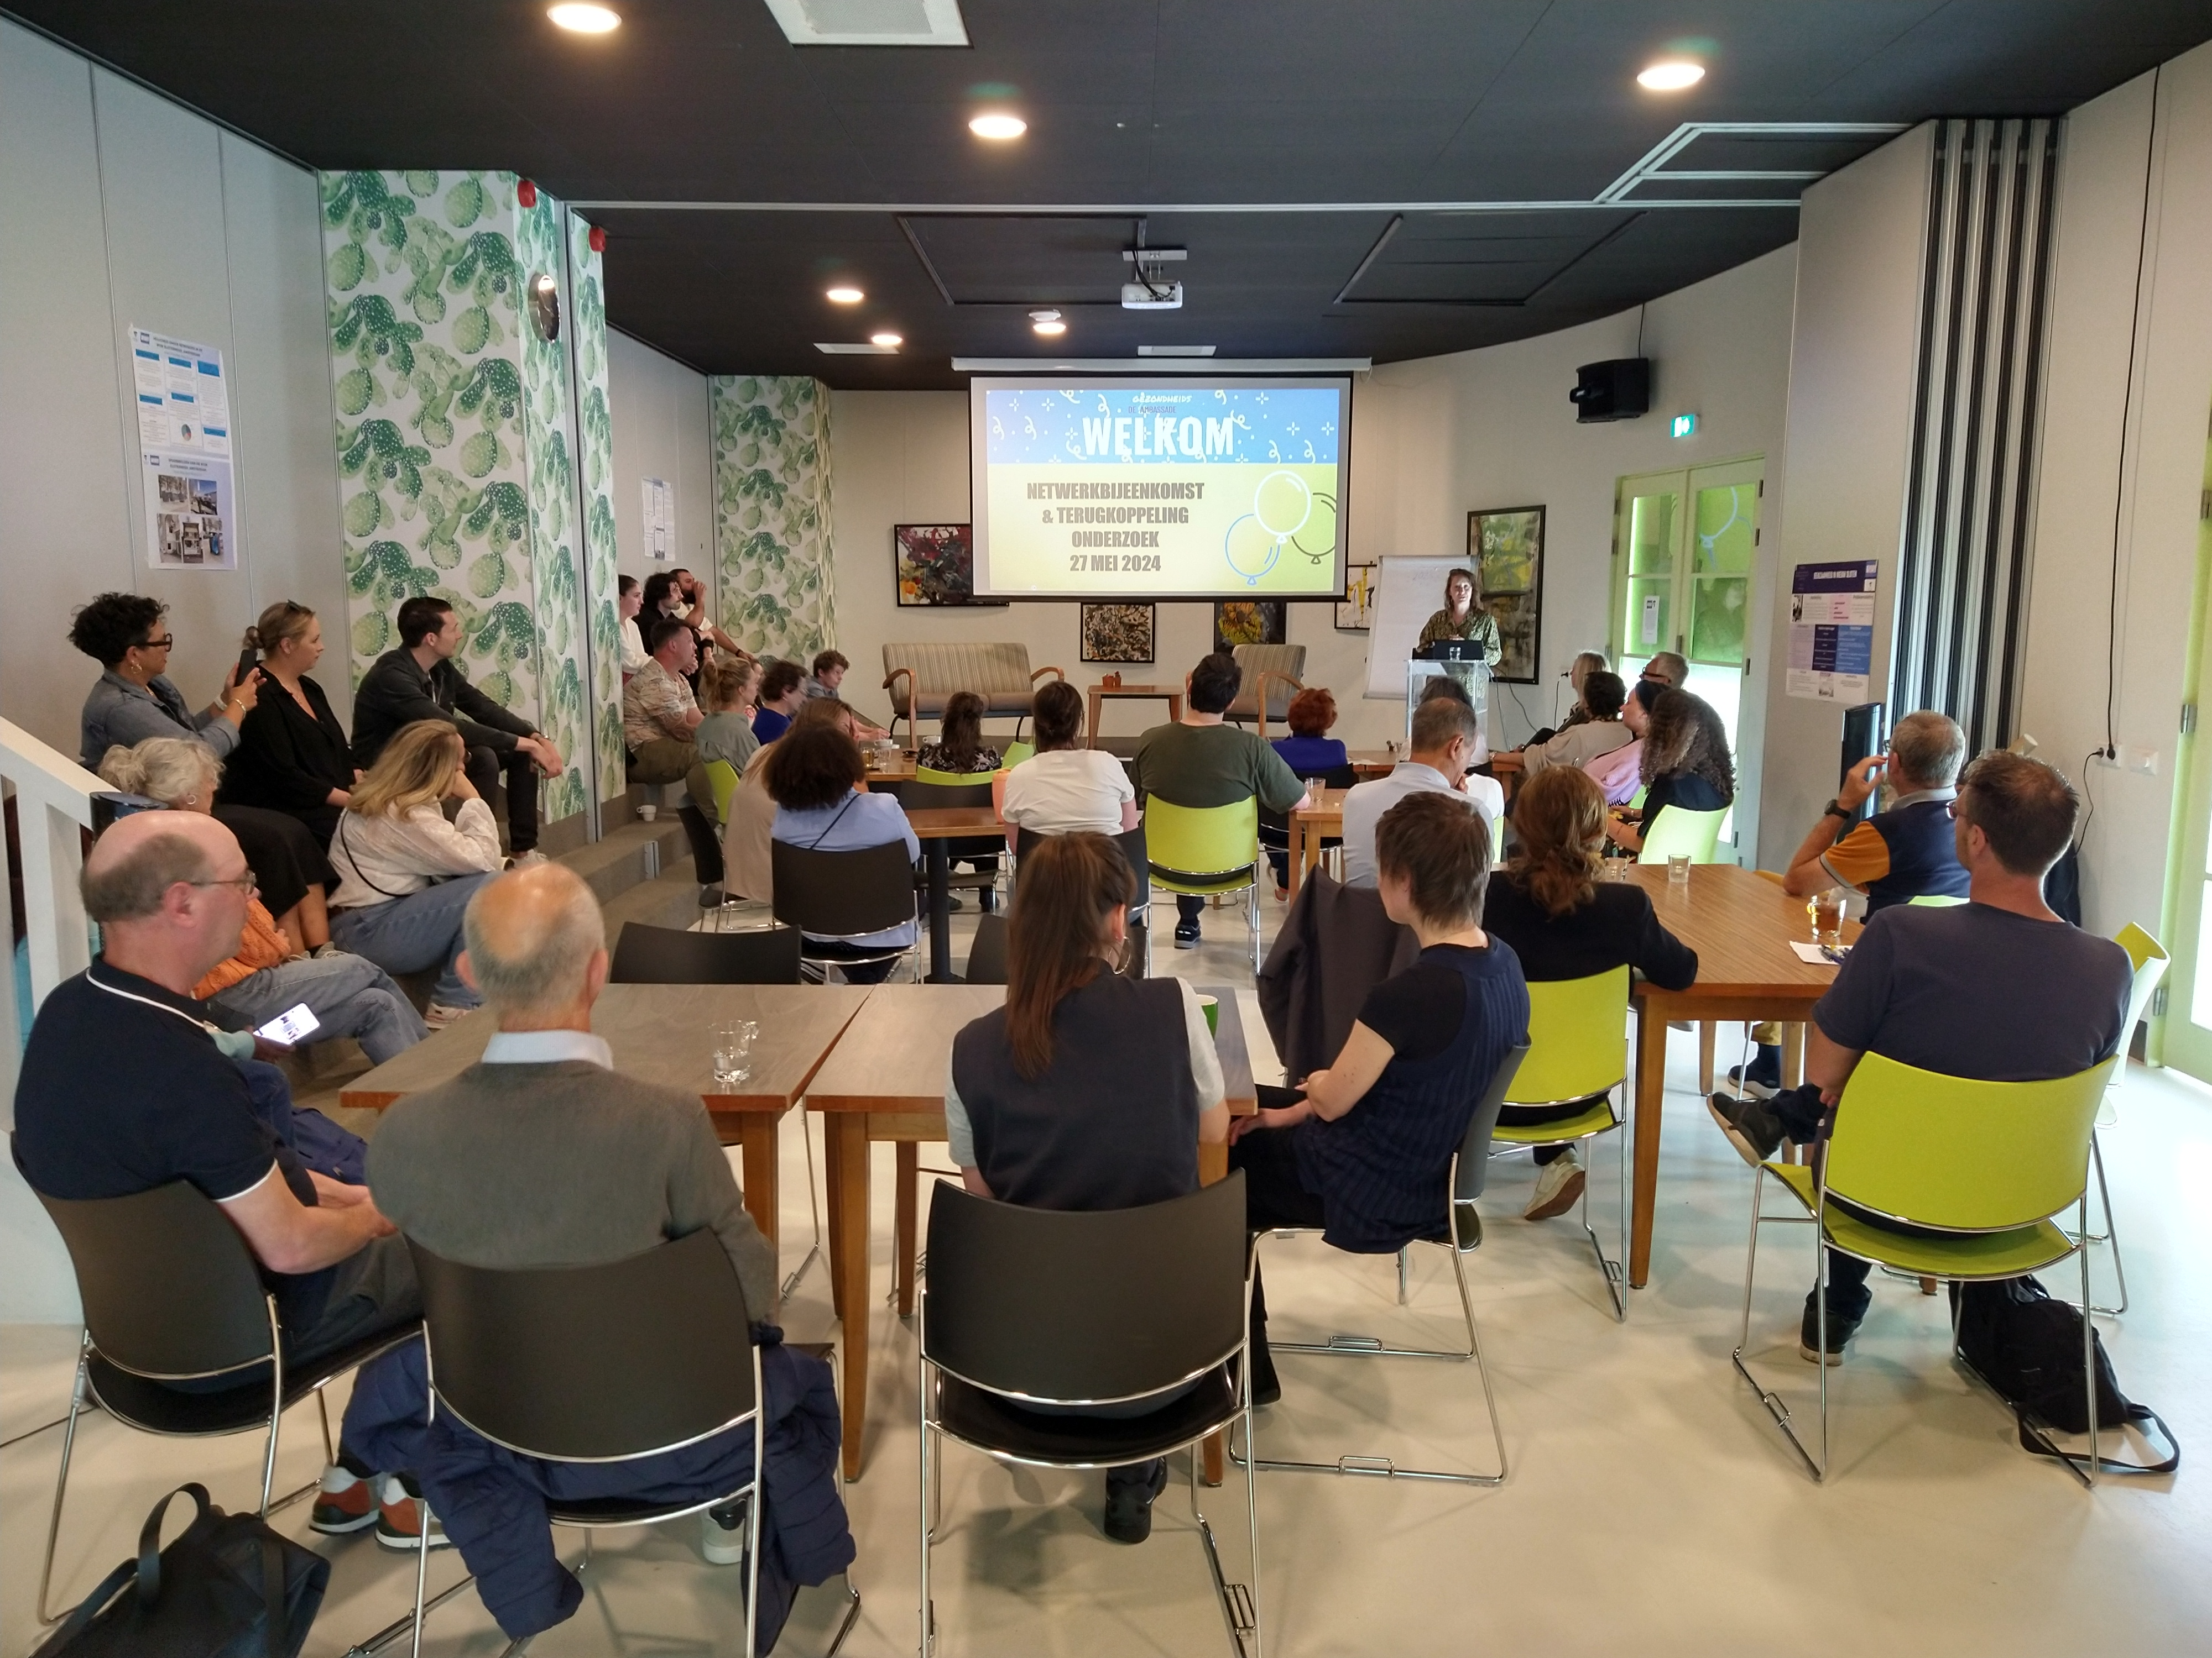
Student data collection
and presentation

Slide 4
Inspiration: D. Silverman (2010)
Interpreting qualitative Data
“Let us imagine a theatre: the curtain goes up and we see a man alone in a room, walking up and down, lighting a cigarette, sitting down, etc. So that we suddenly are observing a human being from outside in a way that ordinarily we can never observe ourselves, it would be like watching a chapter of biography with our own eyes- surely that would be uncanny and wonderful at the same time. (L. Wittgenstein, culture and value, 1980)
“ I see divineness in ordinary things” (Diane Arbus, school essay, age 16)

Slide 5
What did Amsterdam do in the neighborhoods?
About 30 students participated
Community meetings
Surveys
Qualitative interviews and observations
Gathering audiovisual material
All the cities combined, took more than 1250 surveys

Slide 6
Profile questions shared survey
Do you life in this neighborhood? (Yes/No). Only continue if the answer is yes. When the answer is no, then the interview can be stopped after the respondent has been thanked for the short participation.
For how long do you live in this neighborhood? (Less than a year/less than 5 years/less than 10 years/more than 10 years)
Do you agree with the following statement: I enjoy living in this neighborhood/district (Strongly Agree/Agree/Disagree/Strongly Disagree)
What is your age? (Age categories. 0-18, 19-20, 21-30, 31-40, 41-50, 61-70, 71-80, 81-90, 91-100)
What is your gender? (Female/Male/Non binary/I’d rather not answer that)
Where are you born? (This country/ Europe/ Outside of Europe).
Is one of your parents born outside of Europe (Yes/No). Where are your parents born? (This country/Europe/Outside of Europe)

Slide 7
Which of the following categories best describes your employment and/or study status? (Employed, working full-time/ Employed, working part-time/ Self-employed, Not employed, looking for work/ Disabled and-or not able to work/ Studying)
Is the place where you live rented or owned? (Owned/Private Rent/Social Rent)
Are you happy with the quality of your housing (Strongly Agree/Agree/Disagree/Strongly Disagree)

Slide 8
Content question
The following questions are about your neighborhood. Please give these qualities of your neighborhood a score from 1 to 10.
Relations with other inhabitants: it is easy to get to know new people in this neighborhood (1-10)
In this neighborhood, there are enough organizations and facilities to meet local peers (1-10)
There is enough good open space to spend your free time outside(1 tot 10)
Enough is being done to make this neighborhood a clean and healthy living environment. (1 to 10)
This is a good neighborhood for children to grow up (1-10)
This is a good neighborhood for older people (1-10)
This is a neighborhood where people have a hard time making ends meet (1-10)

Slide 9
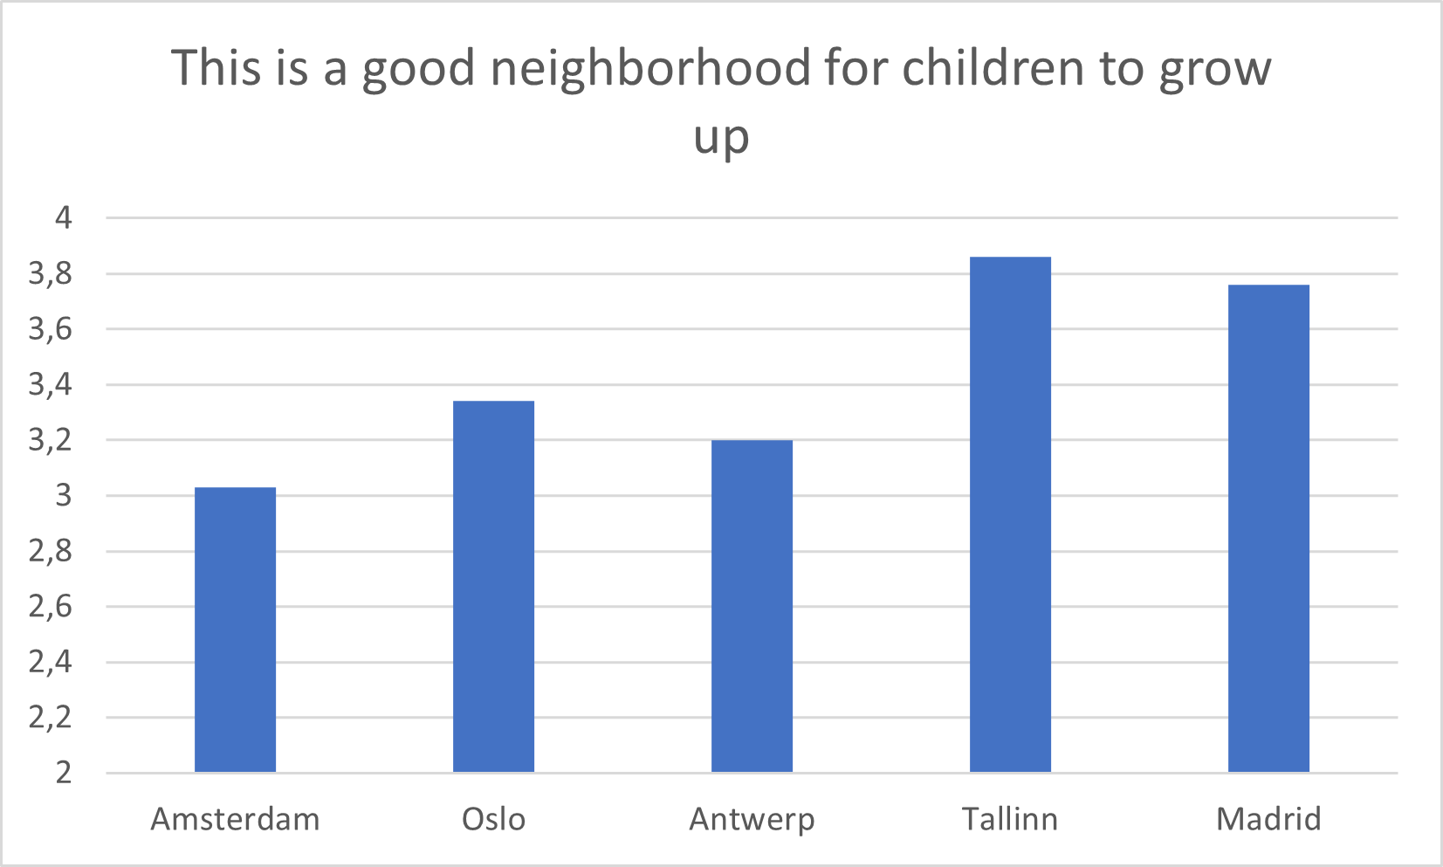
Comparing cities

Slide 10
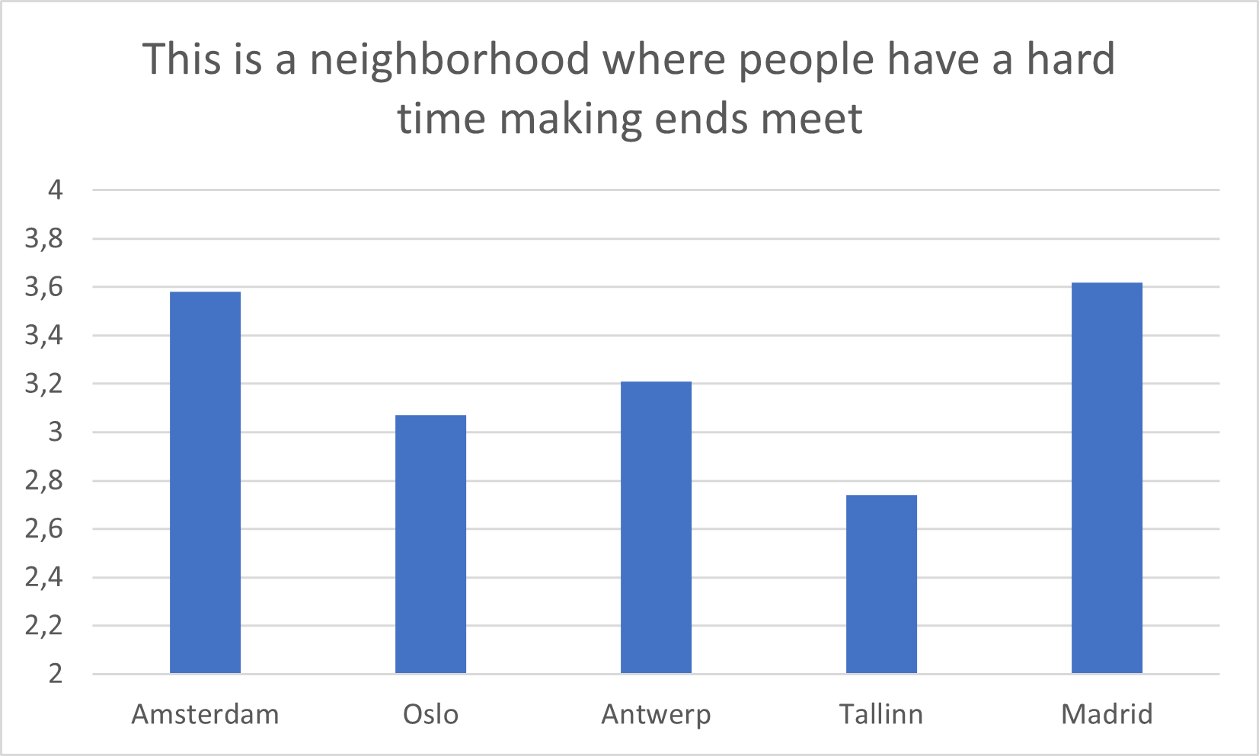
Comparing cities

Slide 11
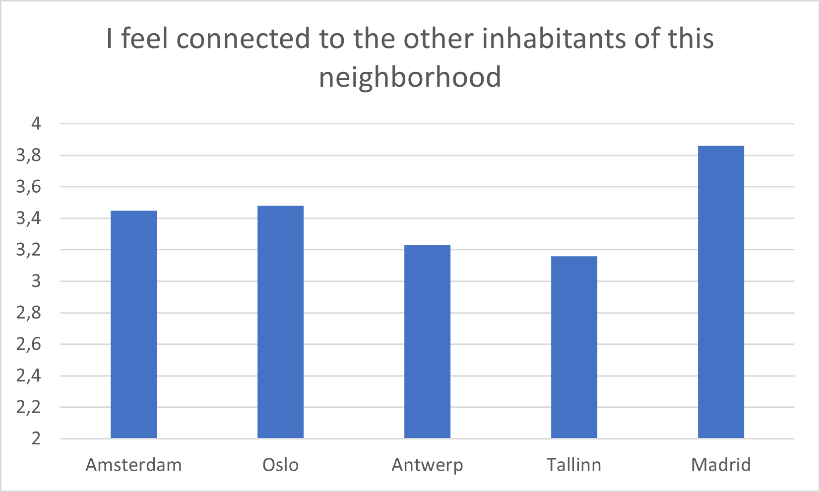
Comparing cities

Slide 12
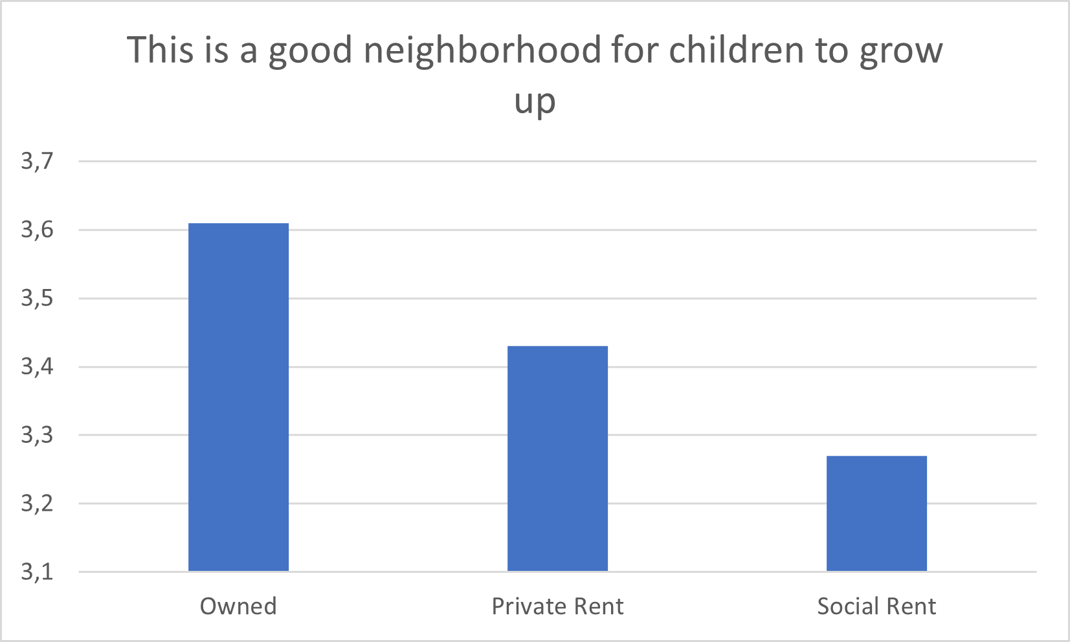
Comparing housing

Slide 13
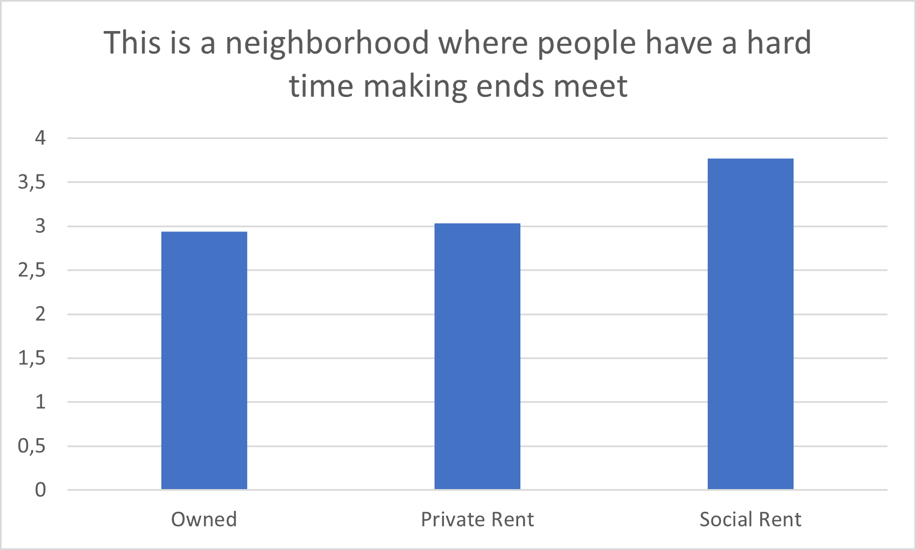
Comparing housing

Slide 14
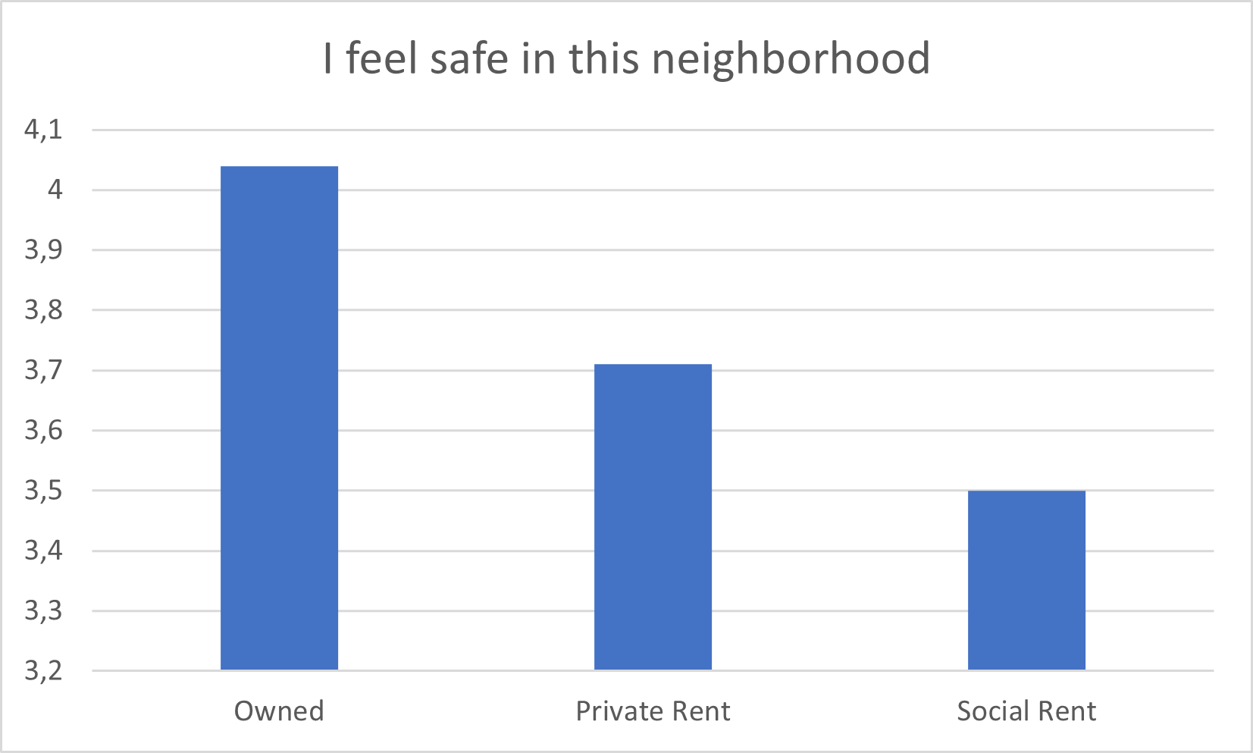
Comparing housing

Slide 15
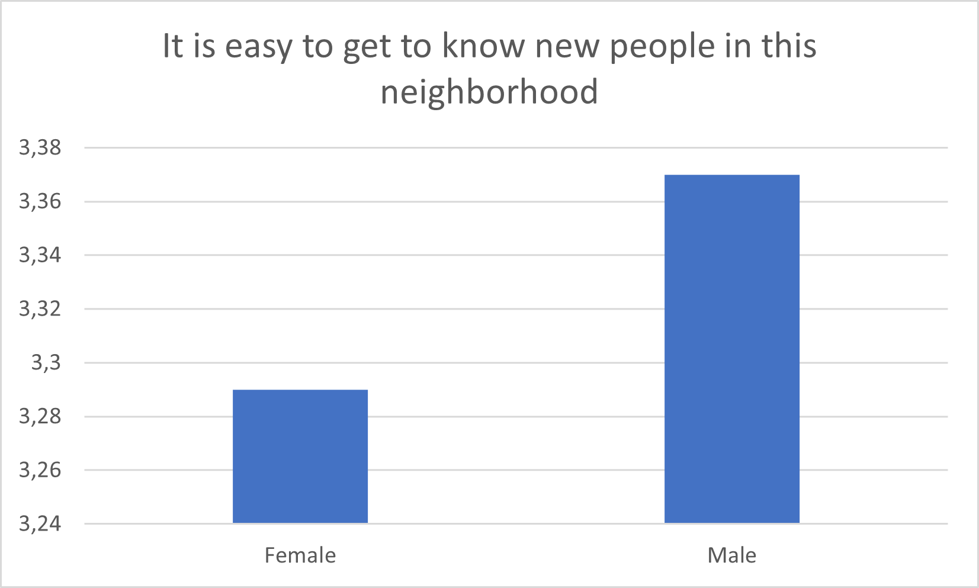
Comparing gender

Slide 16
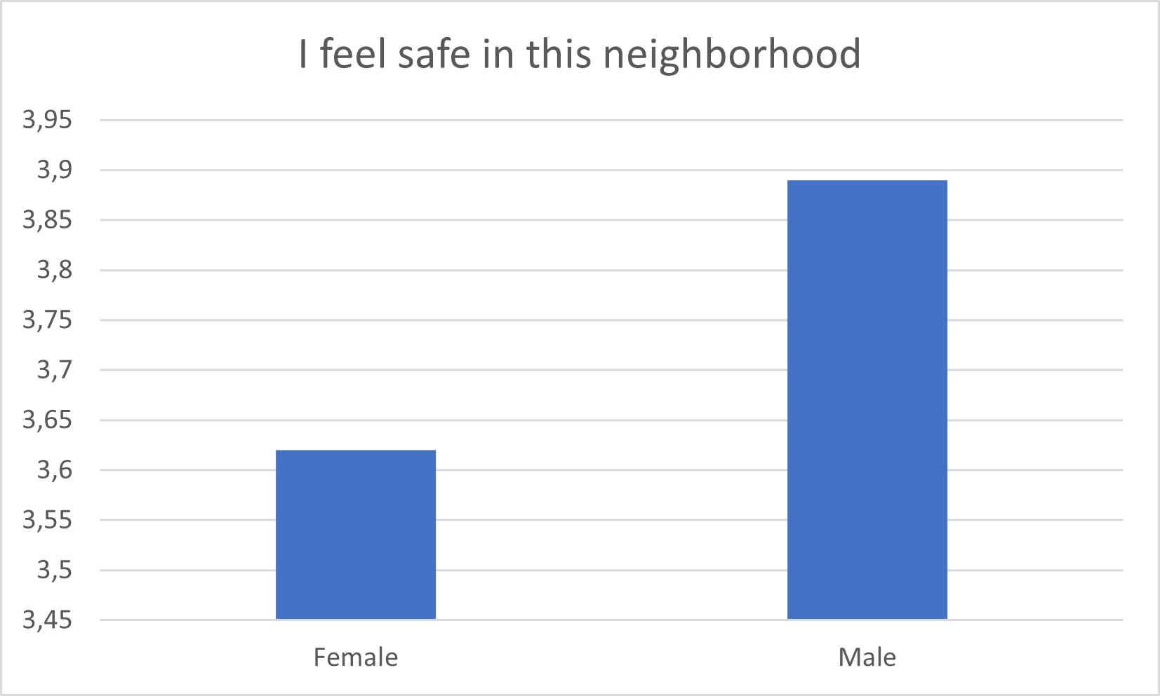
Comparing gender

Slide 17
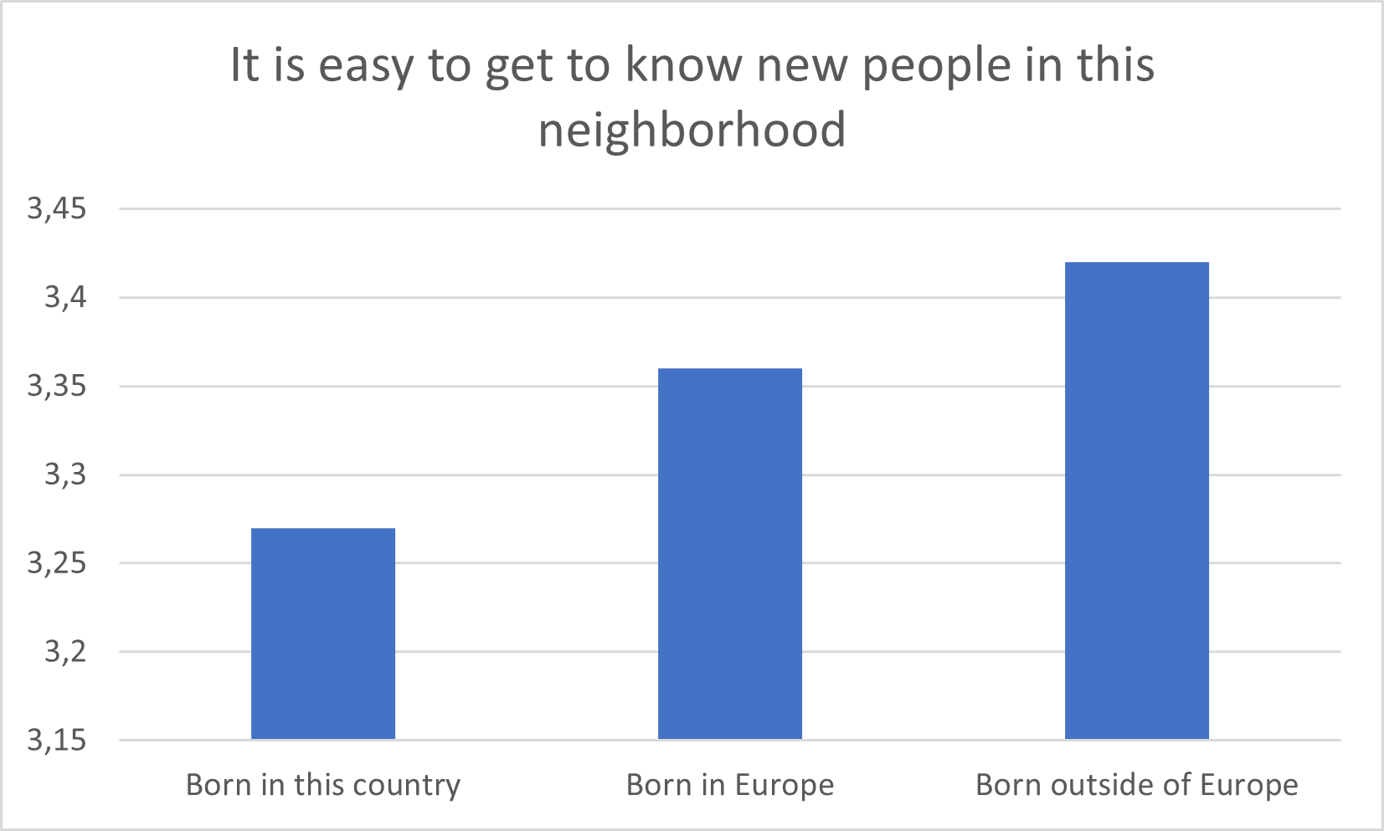
Comparing place of birth

Slide 18
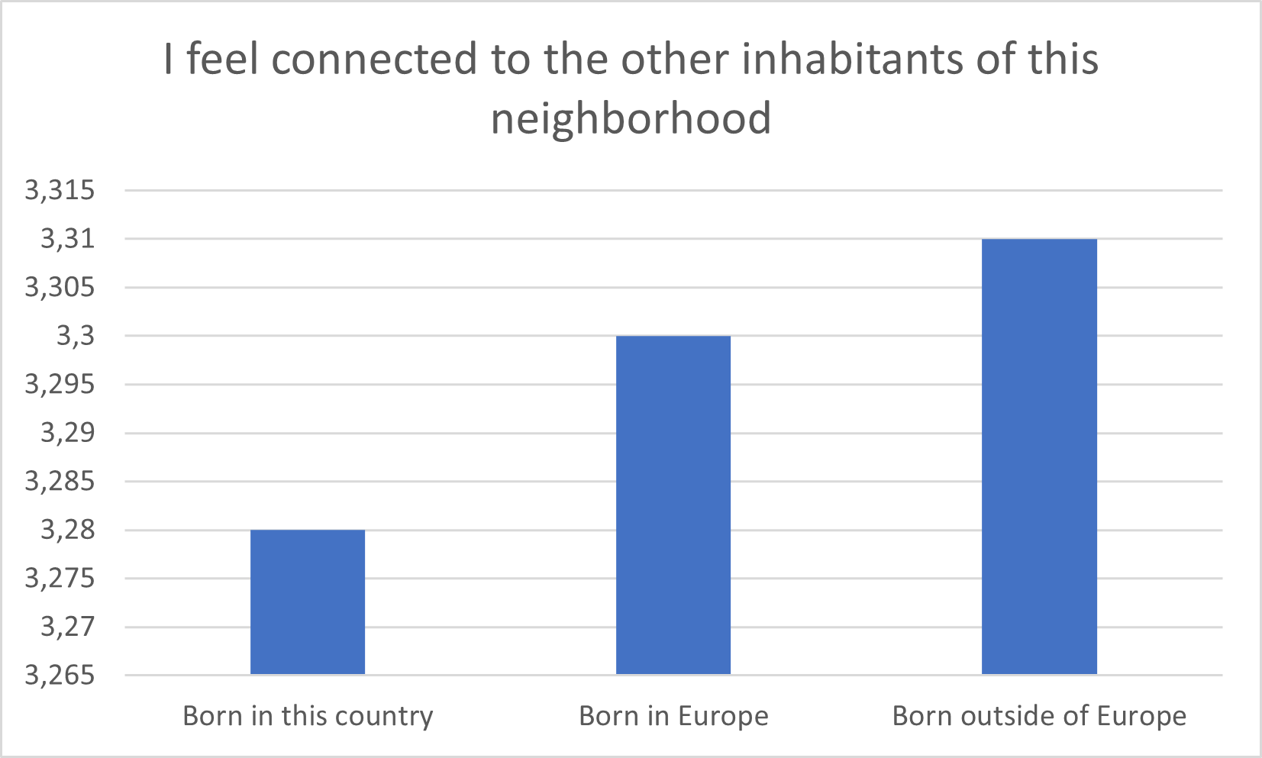
Comparing place of birth

Slide 19

How do we explain those diferences?
Type of neighborhood?
National context?
Type of respondents?
→ use your ‘beginner’ eyes and mind

