Slide 1





LOCUS IP Kick-off

Slide 2
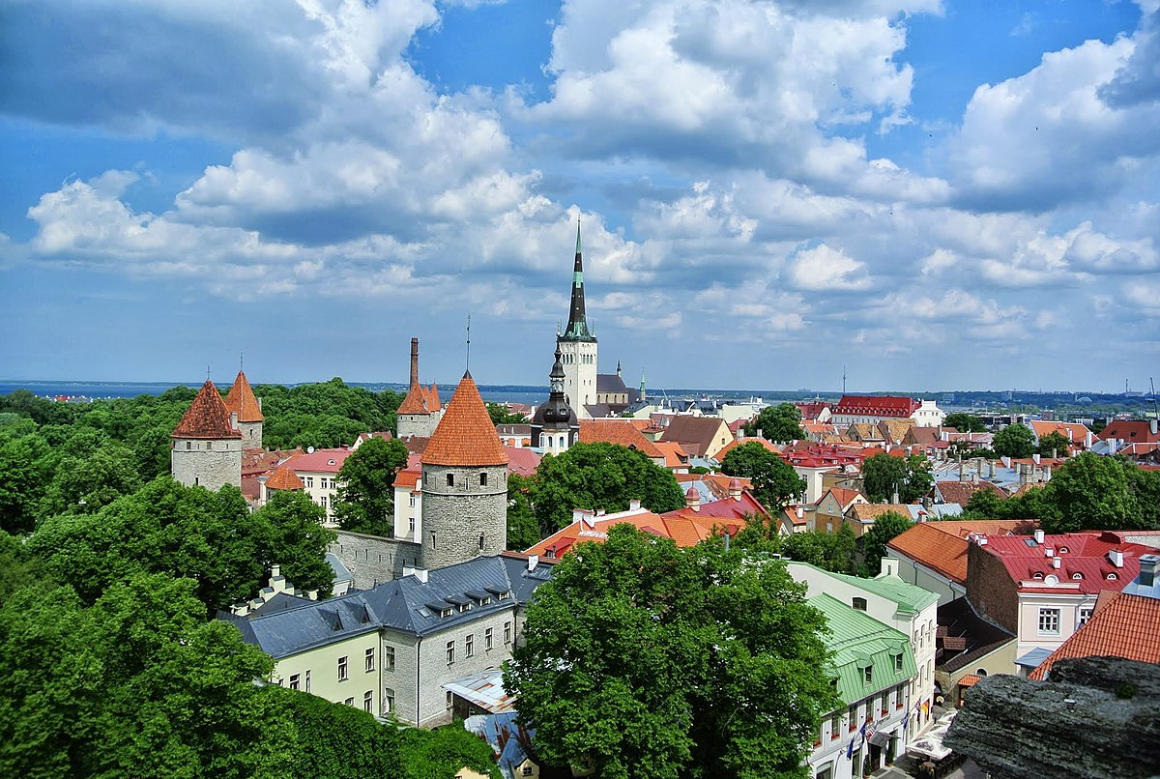
Today's Program
IP Information
Introduction to Tallinn
Break
Meet your international group
Student presentations

Slide 3
Intensive Student Program (IP)
Two goals
  An international exchange of results, experiences and gained knowledge surrounding the LOCUS student program
  Co-create knowledge in an international setting about social issues and social work.

Slide 4
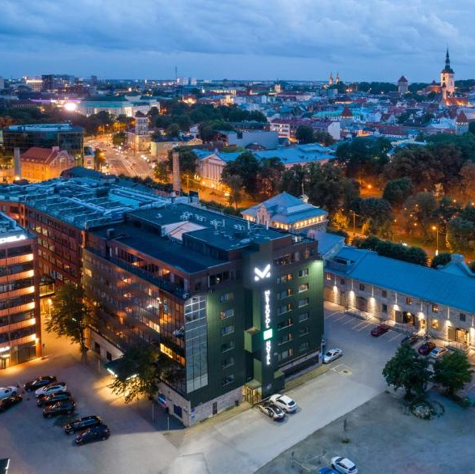
Sunday
Arrive in Tallinn and check-in to the Metropol Hotel
Each city has 2 rooms, one sleeps three, one sleeps two
No program on Sunday so go explore! The hotel is in walking distance from the old city

Slide 5





Monday
09:30 – 16:00
Fully focussed on international exchange
Share experiences, emotions, tips, tops, etc
Work on poster assignment
12.30 – 13.30 Lunch @ Caffee Oaas
19.00 – … Dinner @ F-Hoone

Slide 6
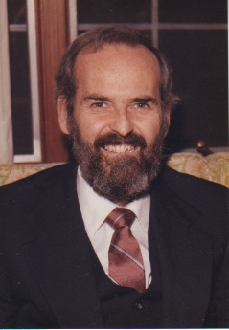
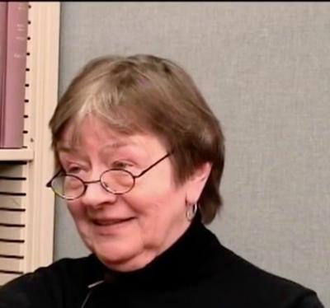
Tuesday
9.30 – 15.30
We’ll work on theory of Lyn Lofland & James Spradley
First try-out observation assignment in student café.
Design an observation plan
13:00 – 14.00 Lunch @ Caffee Oaas

Slide 7
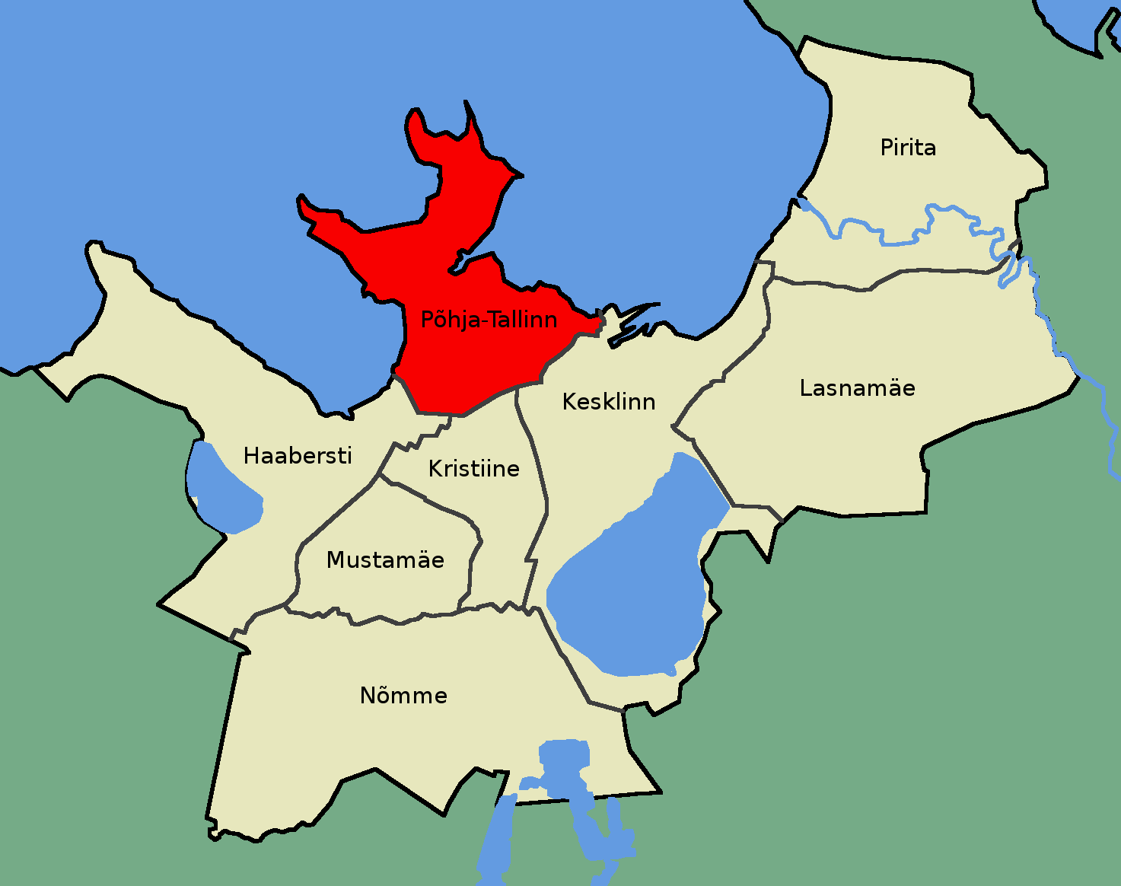
Wednesday
9.00 – 17.00
Field trip to Põhja-Tallinn
  Visit local government
  Walking tour through the neighborhood
  Visit a local community organization
Observation assignment in groups
Lunch not covered by the program

Slide 8

Thursday
No official program
Time to work on the presentation assignment with your group @ Library
13:00 – 14.00 Lunch @ Caffee Oaas

Slide 9

Friday
09.00 – 14.00
Each group presents their findings
13:00 -14:00 Lunch @ Caffee Oaas

Slide 10
IP in a nutshell
Monday | Tuesday | Wednesday | Thursday | Friday
International Exchange | Observation theory and preparation for assignment | Field trip and observation assignment | Prepare for presentation on Friday | Group presentations
Lunch @ Oaas | Lunch @ Oaas | No Lunch | Lunch @ Oaas | Lunch @ Oaas
Dinner @ F-Hoone | Dinner on own accord | Dinner on own accord | Dinner on own accord | Dinner on own accord

Slide 11

Final steps
After this meeting you will receive an email with:
  The official program of the IP with all the details you need
  The mandatory readings for the IP
  A reminder of the homework for the IP

